Slide 1


Encrypt My Data
By Qiming, Simon, Poming, Laige, and Chang

Slide 2
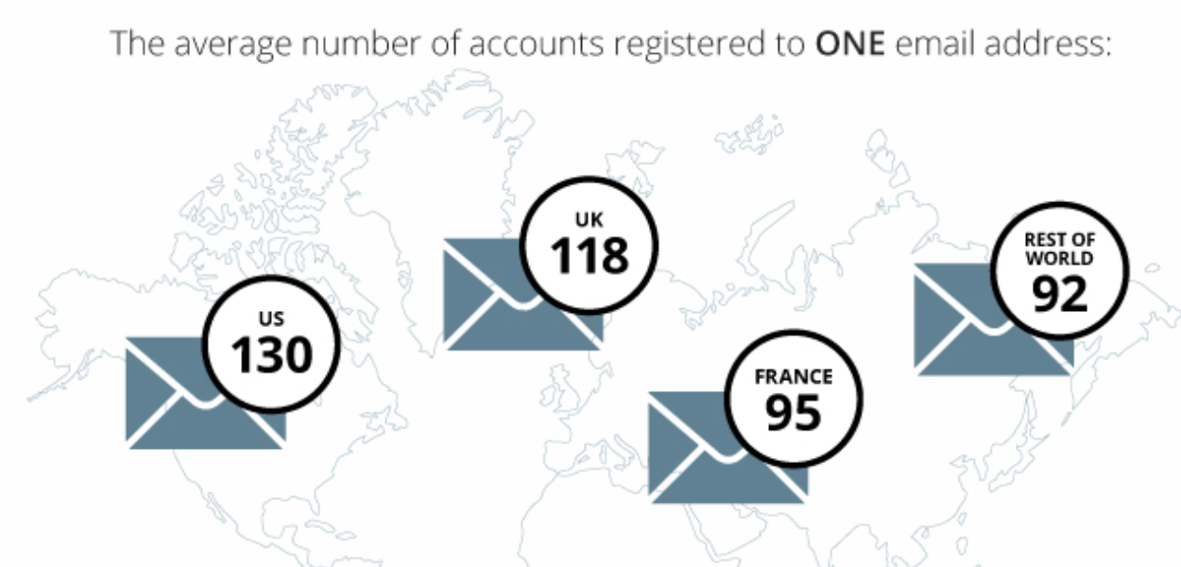
The Need for Password Managers
We have too many accounts!
Source: https://blog.dashlane.com/infographic-online-overload-its-worse-than-you-thought/
Notes:
*Need to clarify fake account generators?

Slide 3
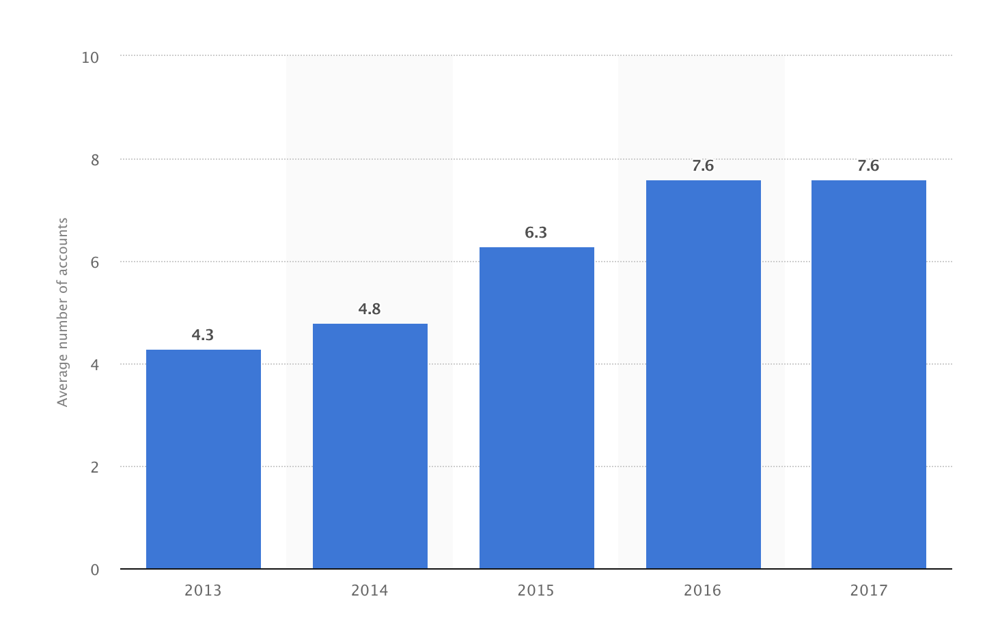
Average Number of Social Media Accounts per Internet User from 2013 to 2017
Source: https://www.statista.com/statistics/788084/number-of-social-media-accounts/
Notes:
Even taking a small subcategory of accounts, we still have too many, we don’t want to use the same password because if one account gets compromised, then all the accounts get compromised, so we need password managers to keep track of all the different passwords

Slide 4


Current Options
1Password
LastPass
Dashlane
Etc.
Etc.
Centralized Database
Notes:
All these options are centralized

Slide 5

Issues
Centralization leaves databases vulnerable to attack
Centralized Database
Notes:
Yahoo, Sony Playstation, Equifax

Slide 6

Issues
Need to trust the databases and companies
Malicious Employee
Centralized Database
Passwords
Notes:
Amazon Alexa, how do you know if the company is storing your passwords encrypted not plaintext

Slide 7
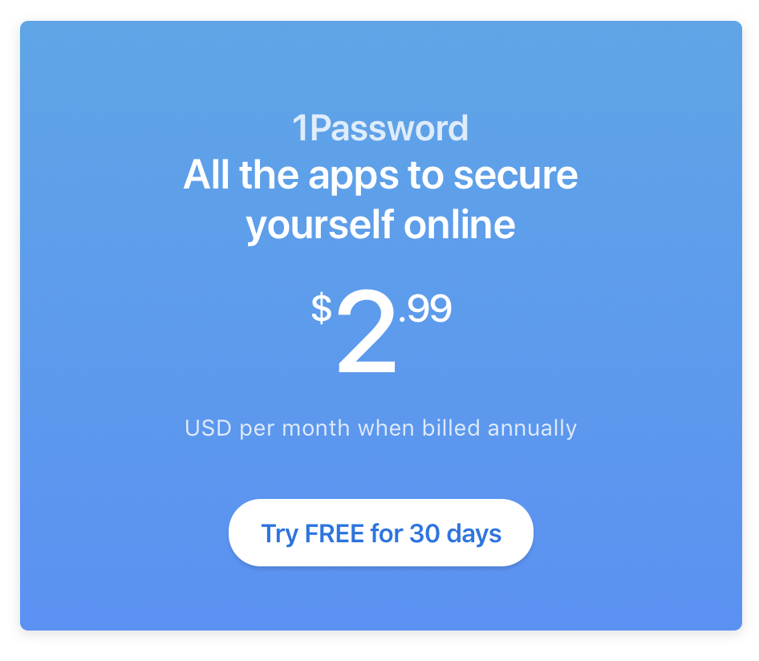
Issues
Fees - Usually subscriptions -> Not one time costs per password

Slide 8
Our Solution
Encrypt passwords using the private key derived from a personal wallet (AES Encryption)
Upload encrypted passwords as a transaction to any stable blockchain
Pull the encrypted password from the blockchain and decrypt with private key to get the passwords for external use
Notes:
AES Encryption, Bitcoin SV (any stable blockchain can work, even original Bitcoin!) **Get screenshots from the actual code**

Slide 9
Our Solution
Txn Hash
0xfe45…..
Read Txn
0xe5….
Execute Txn
Private Key
Encrypted Msg
Ab3…….
Ab3…….
AES Encryption Scheme
Decryption with AES
0xe5….
“Password123”
“Password123”
Private Key
Password
Decrypted Msg

Slide 10
Not very vulnerable to attack
No need to trust any external middleman with your passwords
Creating each password is a one-time transaction fee
Decentralized
Database
Decentralized
Database
X
Txn Fee
Read (NO FEE)
“Pass123”
“Pass123”
Notes:
Not enough hash power, (caveat: editing passwords require txn fee), also mention open-source allows personal verification of the algorithms and methods

Slide 11
Further Explorations
Use ECIES as the encryption scheme
Implement an edit password function
Allow also images and text to be encrypted and saved to the blockchain
Notes:
Use ECIES to prevent browser injections from stealing private keys, and allow decryption to happen locally; Create a way to identify distinct password storages and use timestamps to allow editing of previous passwords; Expand into saving not only passwords but also text and images that users want to save privately and securely

Slide 12
Thank You!

